Slide 1

Calculating complexity
Iterative programs
Recursive programs

Slide 2
Example 1
Maximum value in an array
function maxElement(A): maxval = A[0]
for i = 1 to n-1: if A[i] > maxval:
maxval = A[i]
return(maxval)

Slide 3
Example 2
Check if all elements in an array are distinct
function noDuplicates(A): for i = 0 to n-1:
for j = i+1 to n-1: if A[i] == A[j]:
return(False) return(True)

Slide 4
Example 3
Matrix multiplication
function matrixMultiply(A,B): for i = 0 to n-1:
for j = 0 to n-1:
C[i][j] = 0
for k = 0 to n-1:
C[i][j] = C[i][j] + A[i][k]*B[k][j]
return(C)

Slide 5

Example 4
Number of bits in binary representation of n
function numberOfBits(n): count = 1
while n > 1:
count = count + 1 n = n div 2
return(count)

Slide 6
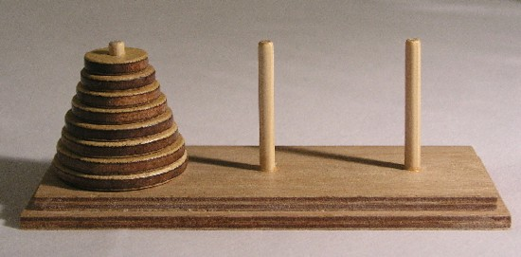
Example 5
Towers of Hanoi
Three pegs, A, B, C
Move n disks from A to B
Never put a larger disk above a smaller one C is transit peg

Slide 7
Example 5
Recursive solution
Move n-1 disks from A to C, using B as transit peg Move largest disk from A to B
Move n-1 disks from C to B, using A as transit peg

Slide 8
Example 5
Solve recurrence by repeated substitution
M(n) = number of moves to transfer n disks M(n) = M(n-1) + 1 + M(n-1)
M(1) = 1
Recurrence
Recursive expression for M(n)

Slide 9
Example 5
Complexity
M(n) = 2M(n-1) + 1
= 2(2M(n-2)+1) + 1 = 2²M(n-2) + (2+1)
= 2²(2M(n-3)+1) + 2 + 1 = 2³M(n-3) + (4+2+1)
= …
= 2^{k}M(n-k) + (2^{k} - 1)
= …
= 2^{n-1}M(1) + (2^{n-1} - 1)
= 2^{n-1} + 2^{n-1} - 1 =
= 2^{n} - 1

Slide 10



Summary
Iterative programs
Focus on loops Recursive programs
Write and solve a recurrence
Will see more complicated examples
Need to be clear about “accounting” for basic operations

